Slide 1
Concept 5. Inflation
What is inflation?
Inflation means prices are rising and the purchasing power of the dollar is declining.

Slide 2
What is inflation rate?
The inflation rate is the percentage increase in prices over a period of time
Examples
The inflation rate for a group of products or services
Medical care
2012-2013: 2.5%
1990 – 2013: 154.9%
Food and beverages
2012-2013: 1.4 %
1990 - 2013: 76.9 %
The inflation rate for all products and services
2012 - 2013: 1.5% (annual inflation rate)
1990 - 2013: 75.6 %
Notes:
Medical services CPI
2012-2013: 414.92-425.13
1990 – 2013 162.8-425.13
Food and beverages
2012-2013: 233.670-236.966
1990 - 2006: 132.1-236.966
General CPI
2012 - 2013: 229.594-232.957
1990 - 2013: 130.7 – 232.957

Slide 3
What is the relationship between inflation rate and the value of your dollars?
The higher the inflation rate, the less the value of your dollars over time.
The table below shows how much 1 dollar will be worth after certain years given certain inflation rates.
For example, the number 50 cents means: At an annual inflation rate of 15%, one dollar will only worth 50 cents after 5 years.

Slide 4
How to compute the numbers in the previous table?
Notations:
Yn=the purchasing power of one dollar after n years
i_{a}=annual inflation rate
n=number of years
Formula:

Slide 5
Examples
At 2% annual inflation rate, how much will $1 worth in 5 years?
At 6% annual inflation rate, how much will $1 worth in 10 years?

Slide 6
One More Example
If the inflation rate is 4% per year, what is the purchasing power of $1000 dollars after 20 years?

Slide 7
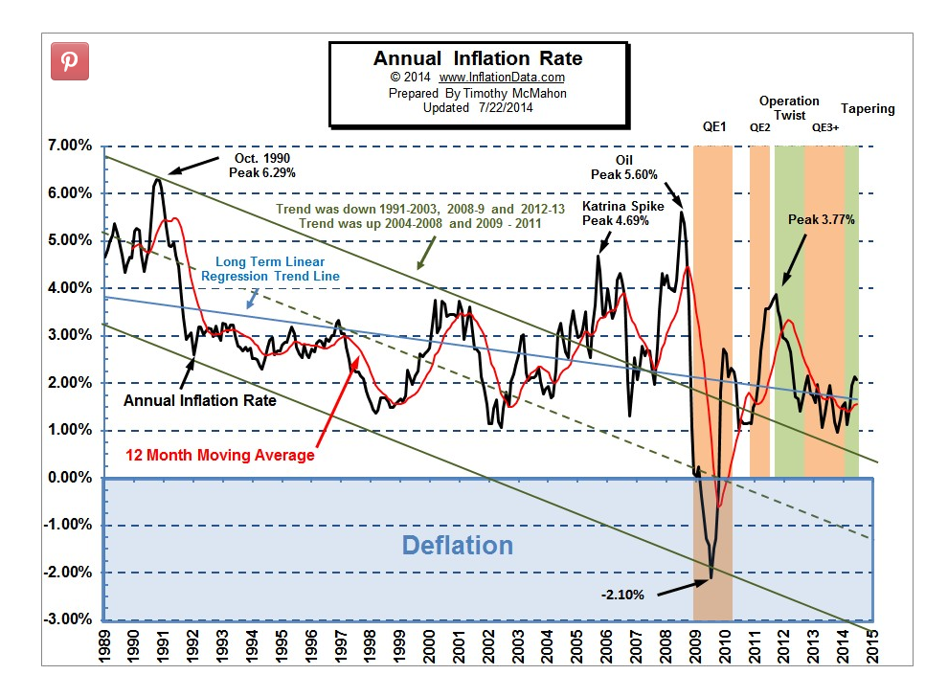
Notes:
http://www.inflationdata.com/inflation/images/charts/Annual_Inflation/annual_inflation_chart.htm
Here is the graph showing annual inflation rate from 1989. The black line is the actual inflation rate, which fluctuates a lot. Since 1989, the highest inflation rate was 6.29% in October 1990, while the lowest inflation rate was -2.10% in 2009, when the great recession started.

Slide 8
What is escalating inflation?
Prices rise at an increasing rate.
Example: 3%, 4%, 5%, 6% for four consecutive years
What is disinflation?
Prices rise at a decreasing rate.
Example: 6%, 5%, 4%, 3% for four consecutive years.
What is deflation?
Prices decline.
Example: -2% inflation rate
in 2009.

Slide 9
How do we know what the inflation rate is?
Inflation rates are computed using Consumer Price Index (CPI)
In the U.S., the Bureau of Labor Statistics (BLS) collects monthly price data on over 100,000 items at 85 different locations across the country from 19,000 retail establishments.
The prices collected are used to form one price index, called the Consumer Price Index (CPI).
The CPI is weighted by commodities’ relative importance in the average consumer's budget.
Weights are obtained from the Consumer Expenditure Survey, also conducted quarterly by the BLS.

Slide 10
Consumer Price Index (CPI)
Visit the CPI website at
http://www.bls.gov/cpi/home.htm
CPI is available for different commodity groups and different regions/areas
1982-1984 CPI=100, set as the base.
Selected Annual Average CPI numbers for urban consumers:
Here is a link to more detailed CPI data.
http://www.bls.gov/cpi/cpid1406.pdf
Year | 1913 | 1960 | 1980 | 1990 | 2000 | 2010 | 2012 | 2013 | 2014
CPI | 9.9 | 29.6 | 82.4 | 130.7 | 172.2 | 218.1 | 229.5 | 232.9 | 236.4

Slide 11
How to compute inflation rate from year A to year B?
Notations:
i_{AB}=inflation rate from year A to year B
CPI_{A}=CPI for year A
CPI_{B}=CPI for year B
Formula:

Slide 12
Examples
The overall CPI in 1992 was 140.3. The overall CPI was 144.5 in 1993. What was the annual inflation rate from 1992 to 1993?

Slide 13
What is the inflation rate from 2001 to 2002, given that 2001 CPI=177.1, 2002 CPI=179.9?

Slide 14
Applications of CPI
CPI can be used to compare standard of living over time.
Suppose that your income was $20,000 in 1992 (year A), and 25,000 in 1997 (year B), were you really better off in 1997 compared to 1992? Note that CPI for 1992 was 140.3, CPI for 1997 was 160.5.
There are three methods one can use to do this comparison. All three will lead to the same conclusion.

Slide 15
Method 1- Converting today’s dollar into yesterday's dollar
In this example we convert 1997 (Year B) income into 1992 (Year A) dollar value
Because $21,854 (1997) > $20,000 (1992), better off in 1997
General formula for converting today’s dollar into yesterday’s dollar:

Slide 16
Method 2. Converting yesterday’s dollar into today’s dollar
In this example we convert 1992 (Year A) income into 1997 (Year B) dollar value
Because $22,880 (1992) < $25,000 (1997), better off in 1997
General formula for converting yesterday’s dollar into today’s dollar:

Slide 17
Method 3. Compare percentage changes of income and price
% change in price from 1992 to 1997 = inflation rate 1992-1997
% change in income = 25000/20000 -1 = 25%
Because income increase at 25% is higher than price increase at 14.4%, better off in 1997

Slide 18
Another Example
Consider the previous salary increase case (salary increase from $20,000 to $25,000) using two different years, say, 1977 -1982? 1977 CPI: 60.6; 1982 CPI: 96.5. In which year was the consumer better off?

Slide 19
Converting 1982 dollars to 1977 dollars
25,000*(60.6/96.5)=$15,699
They were worse off in 1982 because $15,699 <20,000
Converting 1977 dollars to 1982 dollars
20,000*(96.5/60.6)=$31,848
They were worse off in 1982 because 25,000 < $31,848
Comparing changes in prices and income
Total inflation: 96.5/60.6-1=59.2%
% income increase = 25000/20000 -1 = 25%
Same conclusion because price increase > income increase

Slide 20
Concept 6: Interest Rate
Why do interest rates exist? There are three legitimate reasons why interest rates exist
1. Risk: Borrower may not repay, or not repay on time; Your circumstances may change and the money may worth less to you one year later than now. (mortality risk)
2. Opportunity cost: You could use the money on something that derives pleasure
3. Inflation: Money repaid to you in the future is not worth as much as money loaned today in purchasing power.

Slide 21
If you loan money to others, what rate would you charge?
Different people will want to charge different rates because
The risk is different – you want to charge more if the borrower has a bad credit history because you are taking a higher default risk.
Your opportunity cost may be different.
Your estimation of future inflation rate can be different.

Slide 22
Rate of Time Preference
What is rate of time preference?
Some people may have difficulty postponing pleasure, while some others find it easier.
This difference is measured by the rate of time preference.
Individuals with high rates of time preference have a hard time postponing pleasure
More borrowing/spending
Less saving/lending
Individuals with low rates of time preference have an easier time postponing pleasure
Less borrowing/spending
More saving/lending

Slide 23
Real and Nominal Interest Rates
What is nominal interest rate?
Nominal interest rate is the interest rate we observe in the market. It compensates lenders for three things:
the risk they take,
the opportunity cost they incur, and
future inflation.
What is real interest rate?
Because being compensated for inflation is not a real gain for the lenders, real interest rate only takes into consideration two of these three factors:
the risk they take, and
the opportunity cost they incur.

Slide 24
The Relationship between Real and Nominal Interest Rates
Notations:
nr=nominal interest rate (annual)
rr=real interest rate (annual)
i=inflation rate for the loan period (annual)
Formula (note one formula can be converted to the other):

Slide 25
Examples
If you want to charge a 8% real interest rate, and the inflation rate is expected to be 10%, what is the nominal interest rate you should charge?
Note: For all interest rate problems, please keep the decimal point to 6 digits (18.8000% or 0.188000).

Slide 26
Examples
Your savings account pays you an interest rate of 5%. The inflation rate is 3%. What is your real interest rate?

Slide 27
Examples
If you want to charge a 8% real interest rate, and the inflation rate is expected to be 2%, what is the nominal interest rate you should charge?

Slide 28
Examples
Your savings account pays you an interest rate of 7%. The inflation rate is 5%. What is your real interest rate?

Slide 29
Concept 7. Uncertainty and Expectation
What are the uncertainty we face that are important to consumer decision making?
Many, such as future inflation rate, future income, etc.
What do we do when we have to use future information?
We have to make educated guesses about the future.
The key word to scientific guesses is expected value.
Expected value = Sum of (outcome i * probability of outcome i )

Slide 30
Example 1
Expected salary next year
Expected salary next year
= 25,000*50% + 30,000*40% + 20,000*10%
= 12500+12000+2000
= 26,500

Slide 31
Example 2.
Suppose you are taking three classes. The semester has not ended but you need to report your GPA for that semester on your application form for graduate school. What is your expected GPA given the information below?
Expected GPA this semester
= 4*50% + 3.67*35% + 3.33*10% + 3*5% = 3.76750

