Slide 1
Privacy
Griswold v. CT; Roe v. Wade; Planned Parenthood v. Casey
Archive: Meyer v. NE;

Slide 2
Original Right to Privacy
Samuel D. Warren and Louis Brandeis argue in Harvard Law Review (1890) that newspapers are the primary sources of "the unwarranted invasion of individual privacy" and urged that he courts "protect the privacy of private life."

Slide 3
Original Right to Privacy
Justice Brandeis, dissenting in Olmstead v. US (1928), argued that the Constitution "conferred, as against the Government, the right to be let alone - the most comprehensive of rights and the right most valued by civilized men."

Slide 4
Pierce v. Society of Sisters (1925)
Oregon initiative required students to attend public school, with no allowance for private school
Religious school challenges on grounds that law “conflict[ed] with the right of parents to choose schools where their children will receive appropriate mental and religious training”

Slide 5
Pierce v. Society of Sisters (1925)
“The child is not the mere creature of the state; those who nurture him and direct his destiny have the right, coupled with the high duty, to recognize and prepare him for additional obligations.”
J. McReynolds, writing for the Court

Slide 6
Meyer v. Nebraska

Slide 7
Moore v. East Cleveland (1977)
Local ordinance defined family for purpose of zoning as nuclear family so that only spouses, parents/children, and siblings could cohabit
Moore was grandmother living with two grandsons who were first cousins
Sup Ct found that ordinance unnecessarily intruded into family life

Slide 8
Skinner v. Oklahoma (1942)
Oklahoma's Habitual Criminal Sterilization Act of 1935 allowed for compulsory sterilization after three or more convictions for crimes "amounting to felonies involving moral turpitude"
Jack T. Skinner, had been convicted once for chicken-stealing and twice for armed robbery.

Slide 9
Skinner v. Oklahoma (1942)
“In evil or reckless hands [sterilization] can cause races or types which are inimical to the dominant group to wither and disappear. There is no redemption for the individual whom the law touches. Any experiment which the State conducts is to his irreparable injury. He is forever deprived of a basic liberty.”
Justice Douglas (for the Court)

Slide 10
Griswold v. Connecticut

Slide 11
Eisenstadt v. Baird (1971)
MA law prohibited sale or distribution of contraceptives to unmarried individuals
Court finds that right to privacy is individual and not restricted to married couples
Extends Griswold to unmarried individuals

Slide 12
History of Abortion in U.S.
Under Common Law, abortion was legal until “Quickening” (fetal movement, usually (18-24 months)
1821– Connecticut passes 1st abortion law
American Medical Association campaigns to get abortion outlawed in every state

Slide 13
History of Abortion in U.S.
1959 – American Law Institute Model Penal Code allows abortion w/ physician choice
1962 – Thalidomide found to cause birth defects. Sherri Finkbine goes to Sweden for abortion, 52% of public approves, 32% disapprove.
1965 – Rubella epidemic. Gallup Poll finds 77% approve of abortion for birth defects, only 18% approve for economic reasons

Slide 14
History of Abortion in U.S.
1967 – Colorado passes first liberal abortion law, followed by North Carolina and California
1968 – Reform laws passed in Arkansas, Delaware, Georgia, Kansas, Maryland, Mississippi, New Mexico, Oregon

Slide 15
History of Abortion in U.S.
1968 – President Johnson’s Committee on the Status of Women calls for repeal of all abortion laws.
1969 – Sen. Robert Packwood (R-OR) introduces bill to legalize abortion in D.C.
1970 – Hawaii, New York, Washington, Alaska and Florida repeal abortion laws; So. Carolina and Virginia adopt Model Penal Code

Slide 16
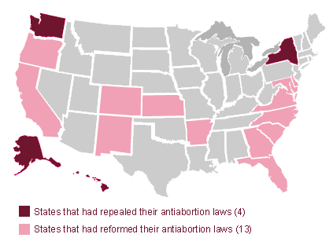
Pre-Roe Legal Reform/Repeal

Slide 17
Roe v. Wade

Slide 18
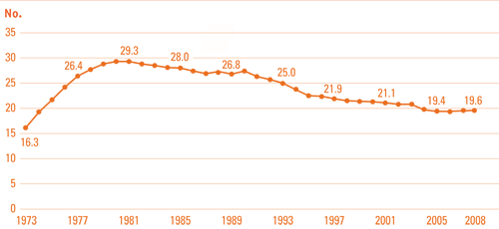
Abortions per 1,000 women aged 15-44, by year

Slide 19
Abortion Characteristics, 2008
 | Women Obtaining abortions | All Women Aged 15-44
Married | 14.8 | 43.6
Not married, cohabiting | 29.2 | 8.4
Not married, not cohabiting | 56 | 47.9

Slide 20
Abortion Characteristics, 2008
 | Women Obtaining abortions | All Women Aged 15-44
Below Poverty Level | 42.4% | 15.9%
>Poverty Level < 200% Poverty | 26.5% | 18.6%
> 200% Poverty | 31.1% | 65.4%

Slide 21
Frequency of Abortion
In 2003, 19.4% of pregnancies ended in abortion (CDC Survey)
Approx. 40% of American women will have an abortion at some point in their lives
Abortion is less common in U.S. than many developing countries (~50% lower than Mexico, for example)

Slide 22
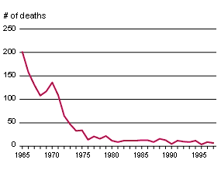
Abortion Mortality pre & post Roe
Notes:
Guttmacher Institute – CDC #s

Slide 23
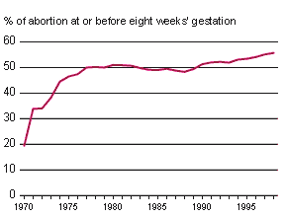
% of Abortions Before 8 Weeks
Notes:
Guttmacher Institute

Slide 24
Ohio v. Akron Center for
Reproductive Health (1983)
Ohio law required 24 hour waiting period, provision of information intended to dissuade woman from having abortion, parental notification (age 16-18) and consent (age 15 and less) without judicial bypass.
Sup Ct found provisions violated fundamental right to privacy

Slide 25
Webster v. Reproductive Health Services (1989)
Missouri law moved trimester framework forward by four weeks to allow for margin of error and better neonatal care and prohibited nontherapeutic abortions in public hospitals
Plurality opinion found privacy to be a liberty interest requiring only ordinary scrutiny

Slide 26
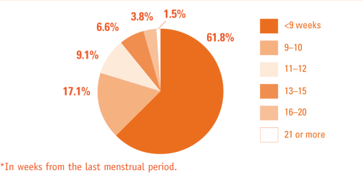
When Women Have Abortions (2006)
88% ≤ 12 weeks, 1.5% ≥ 21 weeks

Slide 27
Planned Parenthood v. Casey

Slide 28
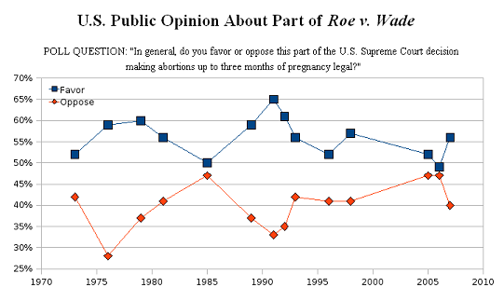

Slide 29
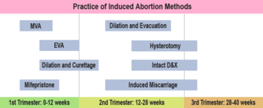
Abortion Methods and Trimester

Slide 30
Gonzales v. Carhart

Slide 31
Ferguson v. City of Charleston

