Slide 1
Gender

Slide 2
Coverture (couverture)
A woman was presumed to be a minor person so long as she stayed in the household of a male relative (father, brother, uncle)
Upon marriage, a woman's legal rights were subsumed by those of her husband. His legal personality “covered” hers.

Slide 3
Bradwell v. Illinois (1872)

Slide 4
United States v. Dege (1960)
Ends coverture in criminal conspiracy case
Common law did not allow conspiracy between man and wife – as coverture meant that they were same legal person

Slide 5
U.S. v. Dege (1960)
It would enthrone an unreality into a rule of law to suggest that man and wife are legally incapable of engaging in illicit enterprises, and therefore, forsooth, do not engage in them.
Justice Frankfurter

Slide 6
Hoyt v. Florida (1961)
Court upheld FL law excusing all women from jury duty unless they volunteered
Court found that women are “still regarded as the center of home and family life” and have “special responsibilities”

Slide 7
Cleveland Board of Education v. LaFleur (1974)
Maternal Leave compulsory when visible, usually 4-6 months
Court found that women were capable of making decisions regarding their own fitness to teach and plan own leave

Slide 8
Pregnancy Discrimination Act of 1978
Women who are pregnant or affected by related conditions must be treated in the same manner as other applicants or employees with similar abilities or limitations
May not refuse to hire pregnant women or require leave so long as can perform duties

Slide 9
Reed v. Reed (1970)

Slide 10
Equal Rights Amendment
Section 1. Equality of rights under the law shall not be denied or abridged by the United States or by any state on account of sex.
Section 2. The Congress shall have the power to enforce, by appropriate legislation, the provisions of this article.
Section 3. This amendment shall take effect two years after the date of ratification.

Slide 11
Equal Rights Amendment
First introduced in Congress in 1923
Proposed by Congress in 1972
Twenty-two states ratified in first year
Thirteen more states had ratified by 1977
Five states voted to rescind by 1977
Original proposal expired in 1979, extended until 1982
Defeated in 1975 in Utah by LDS Church leadership and predecessor of Eagle Forum

Slide 12
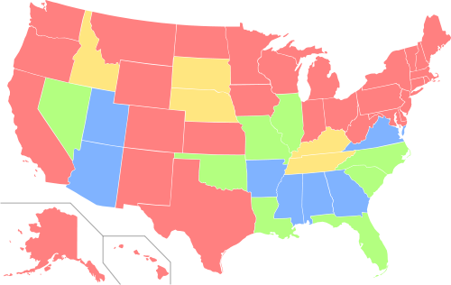
ERA Ratification by State
Red=Ratified, Orange=Ratified/Rescinded
Green=Ratified by 1 house, Blue=Not Ratified

Slide 13
Frontiero v. Richardson (1973)
Female military officers, unlike male officers, had to show they were primary breadwinners to receive certain benefits
Plurality opinion uses strict scrutiny anticipating ERA ratification
Concurrence emphasize irrationality of rule, no need for strict scrutiny

Slide 14
Kahn v. Shevin (1974)
Florida offered a tax break for widows, but not widowers
Challenged on basis of gender inequity
Court upholds policy because of greater financial burden on widows because
1) they live longer
2) less support from pensions

Slide 15
Stanton v. Stanton (1975)
Utah law required non-custodial parent to pay child support for males to age 21, females to age 18.
Sup. Court found lack of rational basis
Question:
What was purpose of Utah law?

Slide 16
Schlesinger v. Ballard (1975)
U.S. military policy allowed discharge of male officers after 9 years without promotion, but gave women 13 years at same rank because women were barred from combat positions
Sup. Ct. upholds policy as properly mitigating women’s lack of access to combat positions

Slide 17
Craig v. Boren (1976)
Oklahoma law prohibited sale of “non-intoxicating" 3.2 percent beer to males under 21, but allowed females over 18 to purchase it.
State’s argument was that there was a higher likelihood that young males would drive drunk

Slide 18
Michael M. v. Superior Court (1980)
Michael M., a 17.5 year-old male, was convicted for statutory rape in CA.
CA’s law defined such unlawful sexual intercourse as "an act of sexual intercourse accomplished with a female not the wife of the perpetrator, where the female is under the age of 18 years."

Slide 19
U.S. v. VA (1996)
VMI, along w/ Citadel, were last two single sex public colleges in U.S.
VA argued that single‐sex education offered distinctive advantages for men that would be fundamentally altered if women were admitted to the program.

Slide 20
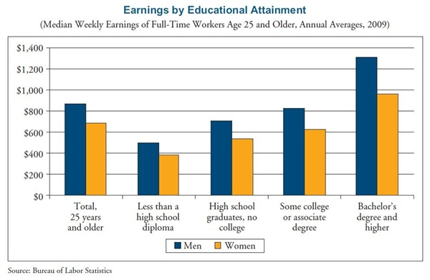
Gender Pay Gap by Education, 2009

Slide 21
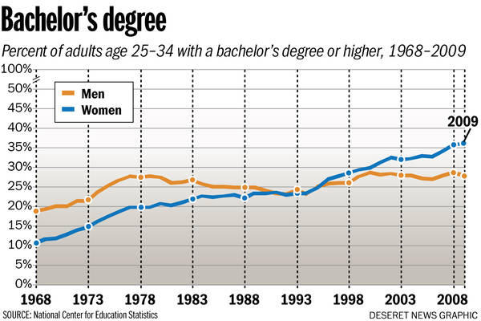
College Degrees by Gender

