Slide 1
LAWYER, n. One skilled in circumvention of the law.
Ambrose Bierce
The Devil’s Dictionary

Slide 2
A Rabbi, a Priest and a Lawyer walk into a bar …

Slide 3
“And God said: 'Let there be Satan, so people don't blame everything on me. And let there be lawyers, so people don't blame everything on Satan'.”
George Burns

Slide 4
"Alas for you lawyers, You have taken away the key of knowledge. You did not go in yourselves and those who were on their way in, you stopped."
Luke 11:52

Slide 5
# of Lawyers v. General Population

Slide 6
How much do lawyers make?
Nationally:
Mean wage: $129,020
Median wage: $113,240
Utah:
Mean wage: $120,150
Median wage: $100,660
Source: Bureau of Labor Statistics, May 2009

Slide 11
Attorney Status vs. Control of Client
Anti-trust
Securities
General Business
Trusts & Estates
Employment
Divorce/Family
Immigration
Criminal Defense
Control of Client
Status

Slide 12
Law as a Profession
Characteristics of a profession:
A public avowal of faith according to a traditional formula, or
The taking of vows on joining a religious order, or
The body of people in a learned occupation, or
An occupation requiring special education.

Slide 13
Law as a Profession
Characteristics of a profession:
Self-direction
Education
Fiduciary duty
Barriers to entry
Organized to discipline its members

Slide 14
A countryman between two lawyers is like a fish between two cats.
Necessity knows no law; I know some attorneys of the same.
Benjamin Franklin

Slide 15
Lawyers on opposite sides of a case are like the two parts of shears; they cut what comes between them, but not each other.
Daniel Webster

Slide 16
If the laws could speak for themselves, they would complain of the lawyers in the first place.
Lord Halifax

Slide 17
A lawyer with a briefcase can steal more than a thousand men with guns. Mario Puzo
Make crime pay.
Become a lawyer.
Will Rogers

Slide 18
A lawyer is a gentleman who rescues your estate from your enemies and keeps it for himself.
Lord Brougham

Slide 19
Lawyer: One who protects us from robbers by taking away the temptation.
H. L. Mencken

Slide 20
Bates v. State Bar of Arizona (1977)
Until 1977, most states prohibited attorneys from advertising.
In Bates, the U.S. Sup. Ct. found that the First Amendment free speech interests of lawyer advertisers were greater than suppression of “unnecessary” litigation and maintenance of profession’s image.

Slide 21
How Often Do Americans Use Attorneys?
Proper context: Disputes and Relationships
As the next two slides show, people are relatively unlikely to go to attorneys and do so after attempting other solutions

Slide 23
Disputing Pyramid

Slide 24
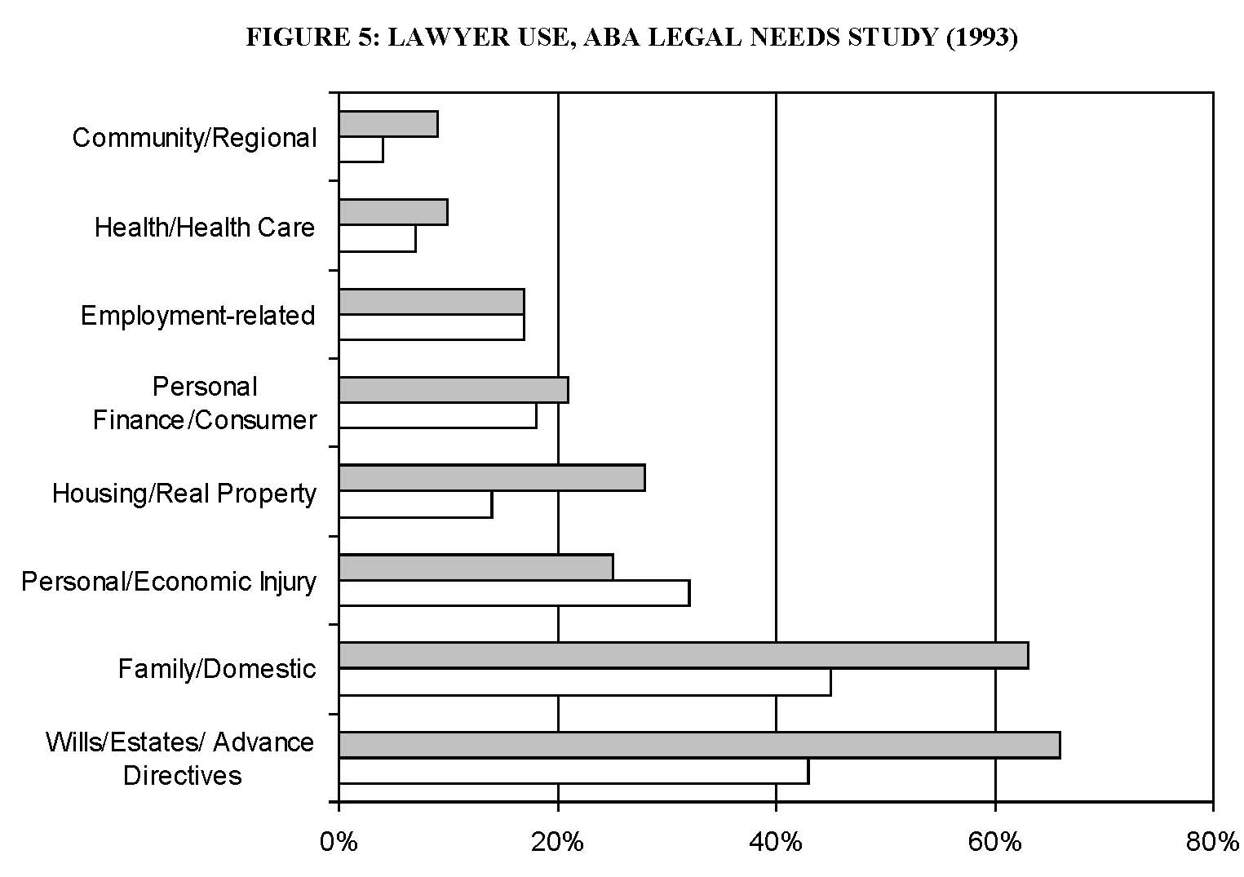
Gray Bars = Moderate Income/ White Bars are Low Income
Notes:
Gray Bars = Moderate Income/ White Bars are Low Income

Slide 25
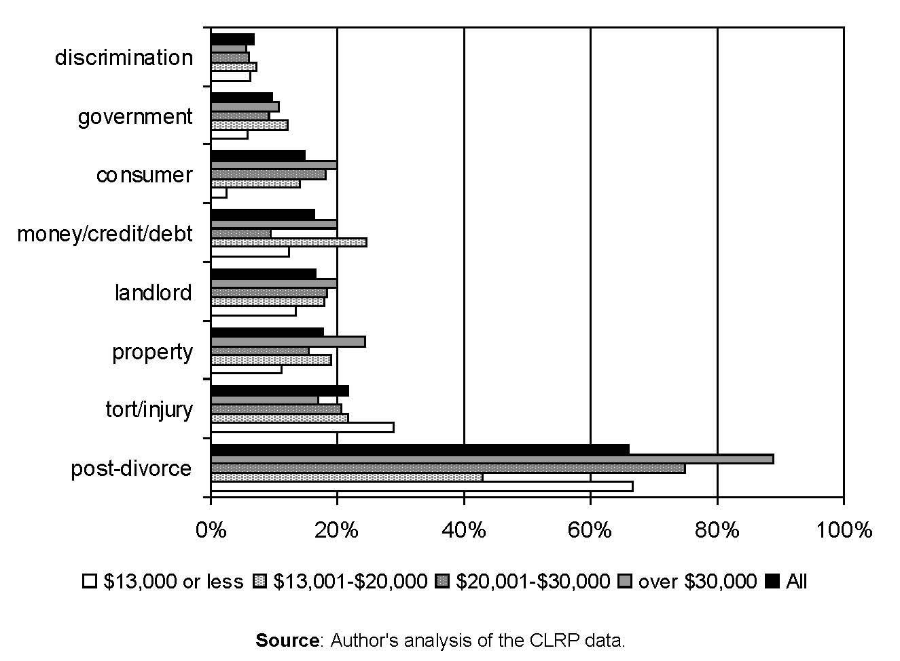
Notes:
Kritzer,

Slide 26
Do Americans Use Lawyers More than Others?

Slide 27
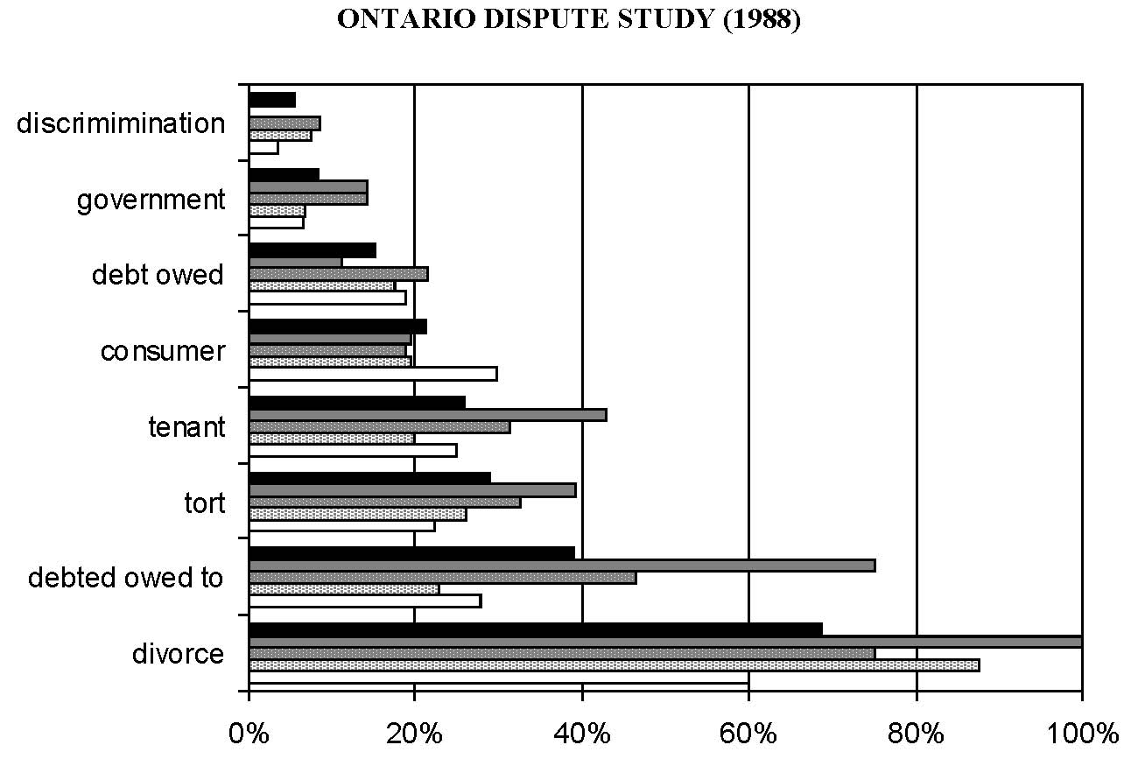
Notes:
Bogart and Vidmar data, from Kritzer,

Slide 28
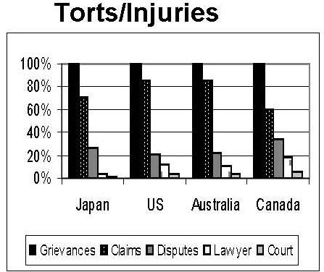

Slide 29
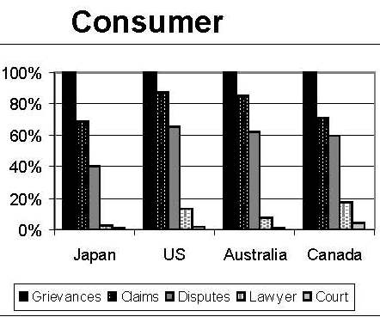

Slide 30
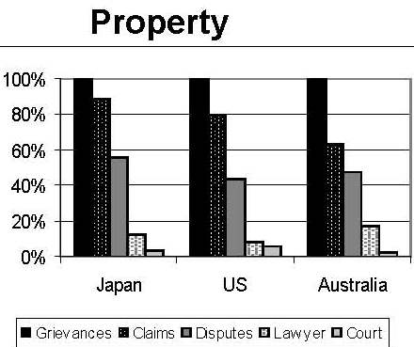

Slide 31
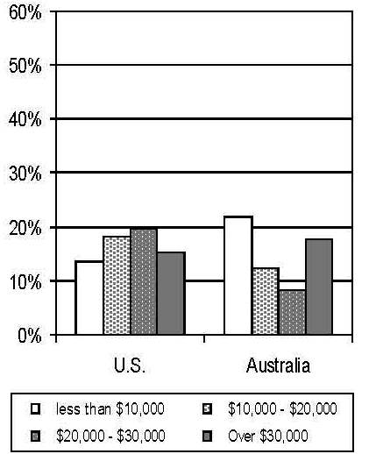
Who uses lawyers? US v. Australia (by issue)

Slide 32
Who uses lawyers? US v. Australia (by stakes)

