Slide 1
McCollum v. Bd of Education (1948)
Champaign Board of Education offered voluntary religious education classes for public school students from grades four to nine.
Weekly 30- and 45-minute classes were led by clergy or lay teachers in public school classrooms during school hours.

Slide 2
McCollum v. Bd of Education (1948)
“the state's compulsory education system … assists … the program of religious instruction carried on by separate religious sects. Pupils compelled by law to go to school for secular education are released … in part from their legal duty upon the condition that they attend the religious classes.”

Slide 3
Zorach v. Clausen

Slide 4
Engel v. Vitale (1962)
NY State Regents adopted prayer for all students:
“Almighty God, we acknowledge our dependence upon Thee, and we beg Thy blessings upon us, our parents, our teachers, and our Country.”

Slide 5
Abington v. Schemp (1963)
Pennsylvania Law required that:
“[a]t least ten verses from the Holy Bible [be] read, without comment, at the opening of each public school on each school day.”
The Schempps, Unitarians, testified that religious doctrines purveyed by a literal reading of the Bible "were contrary to the religious beliefs which they held and to their familial teaching"

Slide 6
Abington v. Schemp (1963)
The State claimed that the purposes of Bible reading included: “the promotion of moral values, the contradiction to the materialistic trends of our times, the perpetuation of our institutions and the teaching of literature.”
The Court found: “even if its purpose is not strictly religious, it is sought to be accomplished through readings, without comment, from the Bible.”

Slide 7
Early State Supreme Courts Striking Down Public School Prayer
Ohio (1869)
Wisconsin (1890)
Nebraska (1902)
Illinois (1910)
Louisiana (1915)
Washington State (1918)

Slide 8
Effect of Decisions by Region 1968
 | Prayer Before Decision | Bible Reading Before Decision | Either Exercise After Decisions | Teachers Ceased | Districts Ceased
East | 83% | 62% | 11% | 87% | 93%
South | 87% | 80% | 64% | 26% | 21%
Midwest | 28% | 38% | 21% | 45% | 54%
West | 14% | 14% | 5% | 64% | 62%

Slide 9
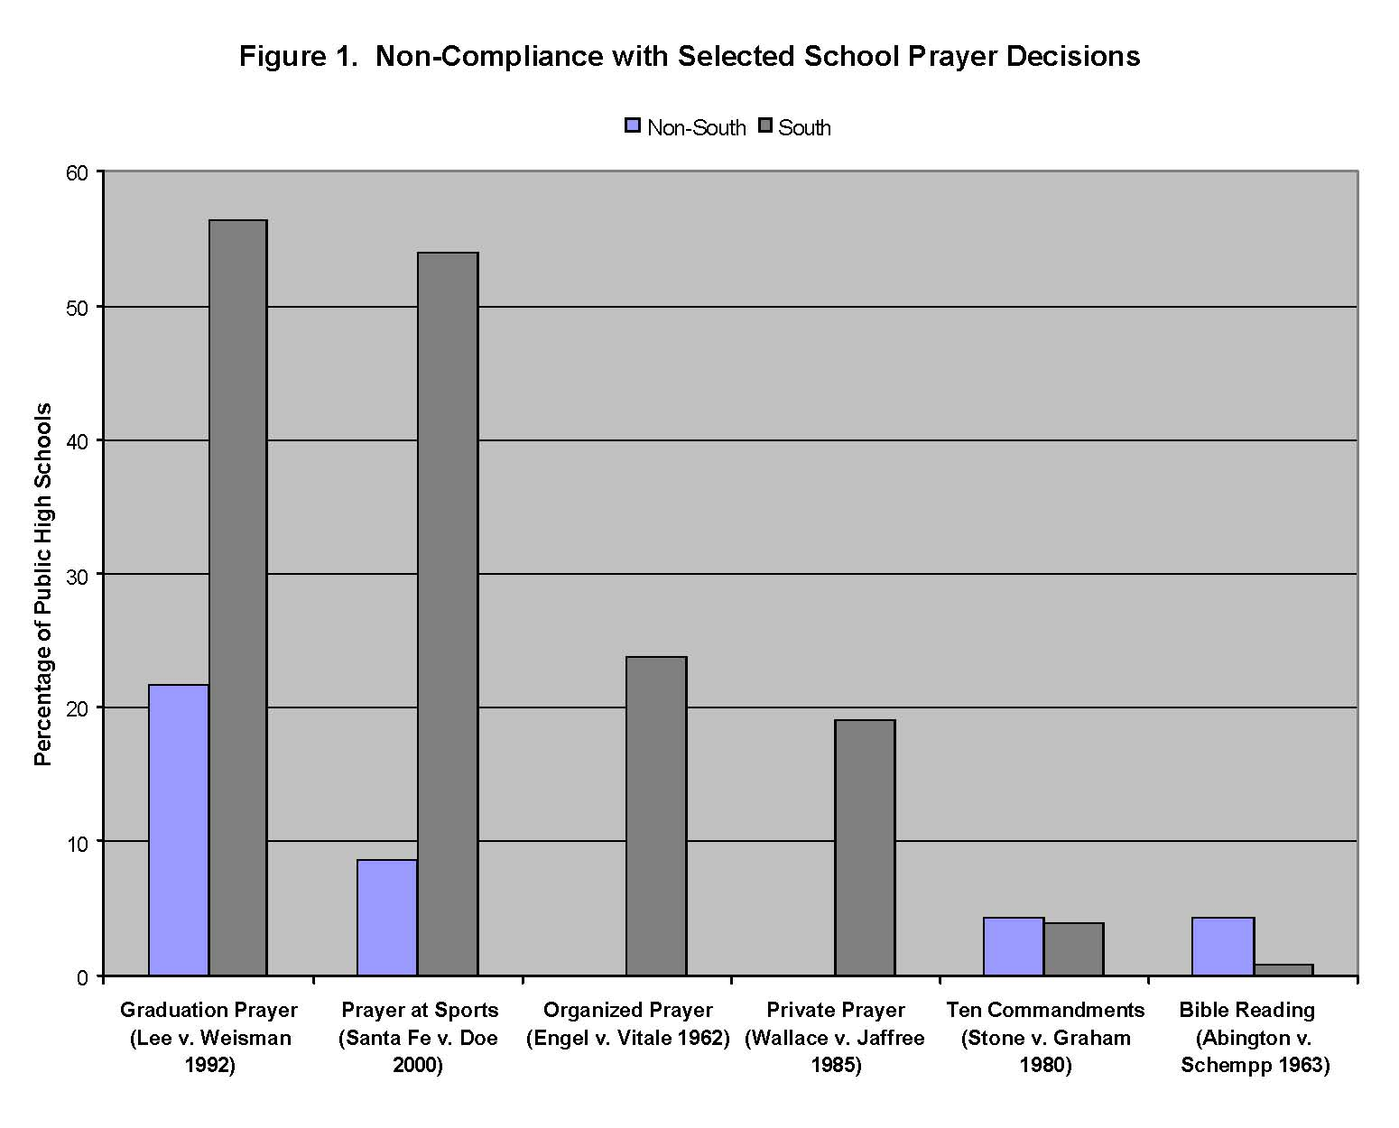
Use graph from McGuire paper

Slide 10
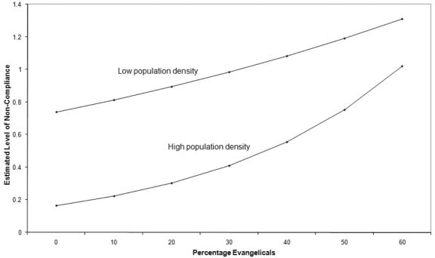
Non-compliance vs. Population Density and Evangelicals
Notes:
Low and high density are defined, respectively, as 500 persons/square mile below or above the mean population density of 969 persons/square mile.

Slide 11
Wallace v. Jaffree (1985): 3 Statutes
1978: authorized 1-minute period of silence "for meditation“
1981: authorized a period of silence "for meditation or voluntary prayer“
1982: authorized teachers to lead "willing students" in prayer to "Almighty God . . . the Creator and Supreme Judge of the world."

Slide 12
Wallace v. Jaffree (1985): 3 Statutes
1978: 1-minute period of silence "for meditation” – stood as constitutional protection of student choice
1981: silence "for meditation or voluntary prayer” invalidated as state is endorsing prayer
1982: struck down by appellate courts as clear state endorsement

Slide 13
Santa Fe v. Doe (2000)
District allowed an elected student “chaplain” to offer Christian (Baptist) prayers over public address system at football games.
Challenged by Mormon & Catholic parents
District court allowed so long as prayers were “nonsectarian” and “non-proselytizing”

Slide 14
Santa Fe v. Doe (2000)
Struck down prayers because delivered "on school property, at school-sponsored events, over the school's public address system, by a speaker representing the student body, under the supervision of school faculty, and pursuant to a school policy that explicitly and implicitly encourages public prayer"

Slide 15
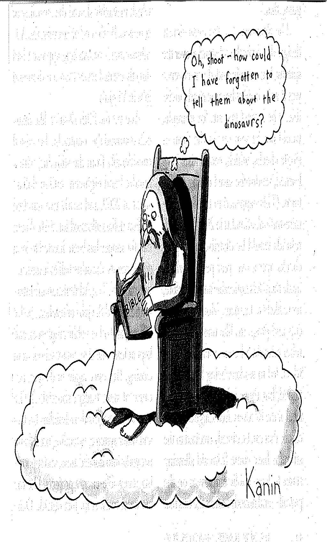
Evolution and the Schools

Slide 16
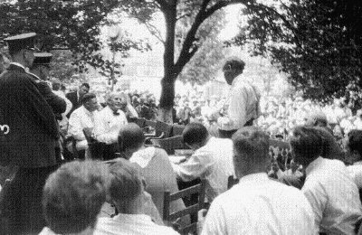
Scopes Monkey Trial

Slide 17
Scopes Monkey Trial (1925)
William Jennings Bryan: "if evolution wins, Christianity goes."
Clarence Darrow: "Scopes isn't on trial; civilization is on trial."

Slide 18
Scopes Monkey Trial (1925)
Darrow asked the jury to find Scopes guilty so that he could appeal the case and overturn law. Jury does so.
Conviction is overturned by TN Sup CT because of technical problem with assessment of $100 fine. Keeps ban on evolution in place – but not enforced.

Slide 19
Epperson v. Arkansas (1967)
“Arkansas' law selects from the body of knowledge a particular segment which it proscribes for the sole reason that it is deemed to conflict with a particular religious doctrine; that is, with a particular interpretation of the Book of Genesis by a particular religious group.”

Slide 20
Edwards v. Aguillard (1987)
"Balanced treatment" means "providing whatever information and instruction in both creation and evolution models the classroom teacher determines is necessary and appropriate to provide insight into both theories in view of the textbooks and other instructional materials available for use in his classroom."

Slide 21
Scalia in Edwards
"Perhaps what the Louisiana Legislature has done is unconstitutional because there is no such [scientific]evidence [of creation], and the scheme they have established will amount to no more than a presentation of the Book of Genesis. But we cannot say that on the evidence before us in this summary judgment context.”

Slide 22
Kitzmiller v. Dover (PA) Area School District (2005)
Conservative Republican federal District Judge found:
“The overwhelming evidence at trial established that I[ntelligent] D[esign] is a religious view, a mere re-labeling of creationism, and not a scientific theory.”

Slide 23
Kitzmiller v. Dover Area S. D. - Standards
“Because Darwin's Theory is a theory, it is still being tested as new evidence is discovered. The Theory is not a fact. Gaps in the Theory exist for which there is no evidence. A theory is defined as a well-tested explanation that unifies a broad range of observations.
“Intelligent design is an explanation of the origin of life that differs from Darwin's view.”

