Slide 1
Anthropology and Your Day Job
Ted Coxworth
Director of Analytics, Progrexion

Slide 2
Setting the Stage

Slide 3
About Me
Director of Analytics, Progrexion
Mid-size (~3k employees) credit repair company.
My team answers business questions with science.

Slide 4
An Example: Do Surveys Help?
Lift from Survey?
Are completers different? If so, we should compare them to similar customers in the control group.
4

Slide 5
An Example: Do Surveys Help?
No lift from Survey.
5

Slide 6
About Me
Director of Analytics, Progrexion
Mid-size (~3k employees) credit repair company.
My team answers questions with data, stats, and science.
Anthropologist
BA, MS, and PhD – all in Anthropology
Lots of time spent doing research

Slide 7
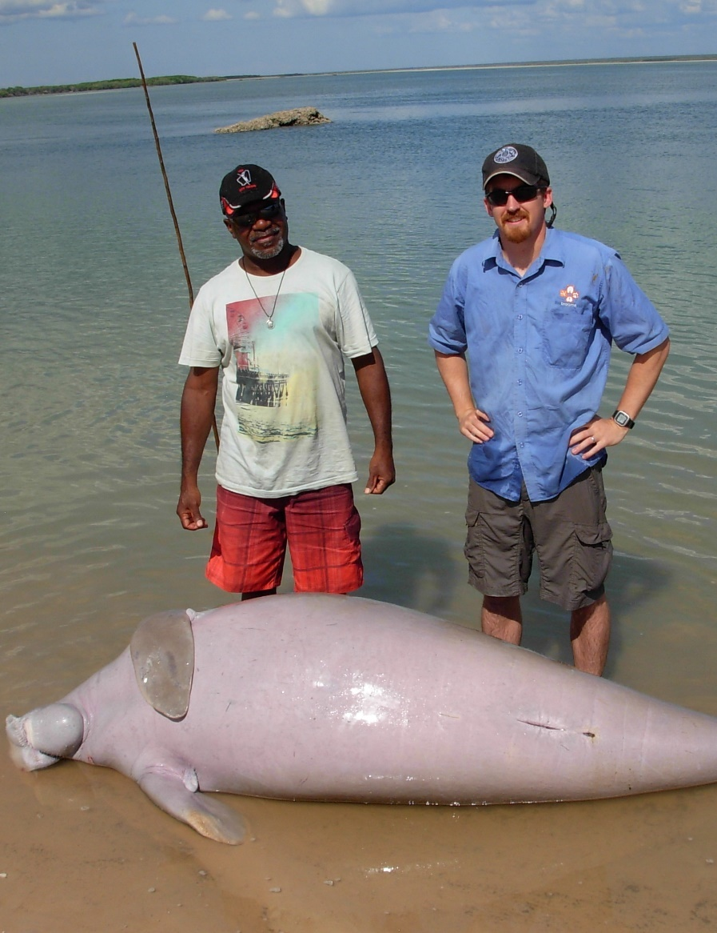
About Me

Slide 8
About Me

Slide 9
What Anthropology Taught Me
Science is fun – and practical.
Useful perspective on the human animal.
Statistics are incredibly handy inventions.
Human behavior
Particle physics
Automotive manufacturing
Netflix recommendations
Buzzfeed quizzes (j/k)

Slide 10
Hints on the Hunt
LinkedIn
A tool for recruiters.
Resume
Gateway to the interview.
Interview
Where magic happens (or not).
OR
Network
Best way to get a job – especially your first one.

Slide 11
Get In Touch
Ted Coxworth
Phone: (801) 204-5122
Email: tcoxworth@progrexion.com
LinkedIn: Ted Coxworth

